Slide 1


APP ANALYSIS

Slide 2










TEAM-02 (DRACARYS)
P. Darshana (13)
E. Akash(04)
M. Akash(05)
T. Hariharan (23)
Team Leader
Member 1
Member 2
Member 3
S. Rajasarathy (42)
R. Rajesh (43)
V. Akshaya (07)
B. Agalya(03)
Member 4
Member 5
Member 6
Member 7
Chief Product Officer
Project Manager

Slide 3


Table of Content
Problem Statement
Abstract
Methodology
Analysis Insights
Conclusion

Slide 4
Problem Statement
Abstract
Methodology
Analysis Insights
Conclusion
PROBLEM STATEMENT
With thousands of mobile apps entering the market daily, choosing the right category for a new app development project is a critical decision. The client is facing the challenge of identifying which app category offers the best potential for success. Without data-driven insights, investing in the wrong category could lead to poor user adoption and business loss.
Therefore, a comprehensive analysis is required to determine the most suitable app category to target for the next project.

Slide 5
Problem Statement
Abstract
Methodology
Analysis Insights
Conclusion
ABSTRACT
With the rapid growth of the mobile app industry, choosing the right app category for future development has become a crucial decision for success. This project aims to assist the client in identifying the most promising app category by analyzing key factors such as ratings, reviews, number of installs, app type, and content rating. Using Power BI, we processed and visualized app data to uncover trends and performance patterns across different categories. The analysis revealed that certain categories consistently outperform others in terms of user engagement and popularity. Based on these insights, the project provides a data-driven recommendation to help the client make an informed decision for their next app development initiative.

Slide 6
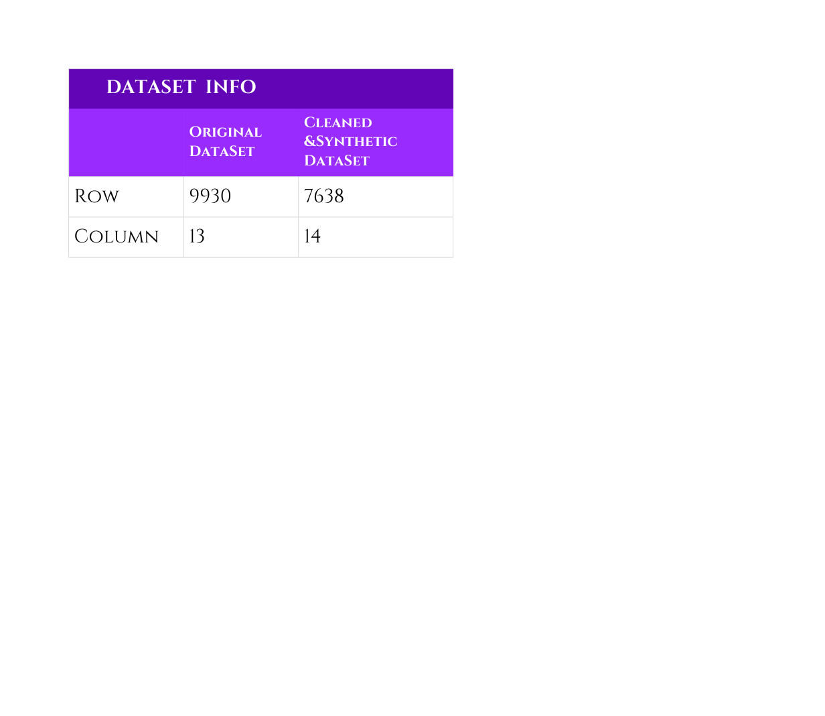
Problem Statement
Abstract
Methodology
Analysis Insights
Conclusion
METHODOLOGY
1) Data Collection and Exploration
Dataset Name: google_playstore_app
Features:
App Name, Category, Rating, Reviews, Installs, Size, Price, Content Rating, Genres, Last Updated, Location
Exploration and Cleaning:
1) Basic Check:
info, desc, column, unique, head, tail, is.null()
2) Fixes Incorrect Formating (Change as Numeric)
Remove ‘M’ from size, Remove ‘+’, ‘,’ from installs
3) Data Type Conversion:
Reviews to numeric
4) Handling NULL VAlue
Drop and Immute by Mean

Slide 7
Problem Statement
Abstract
Methodology
Analysis Insights
Conclusion
2) Data Analysis (Top 5)
(i) How many apps are there in each category and what’s their average install count?
Insights: Which Category is best for to future app building
Chart: Combo(Column + Area)
(ii) Which content rating and category combination drives the most installs?
Insights: Which is used to Identify the Target Audience by age (Adult, Teen, Everyone)
Chart: Clustered Bar Chart
(iii) What is the average rating for each app category over the year?
Insights: How the Rating is Distributed Over a Year (Time Series)
Chart: Line Chart
(iv) What is the app lifecycle App — from launch to out-of-market status?
Insights: How the App turns to out-of-market
Chart: Funnel
(v) How are app versions distributed across categories?
Insights: Understands version fragmentation and maintenance status.
Chart: Stacked Bar/ Pie chart

Slide 8
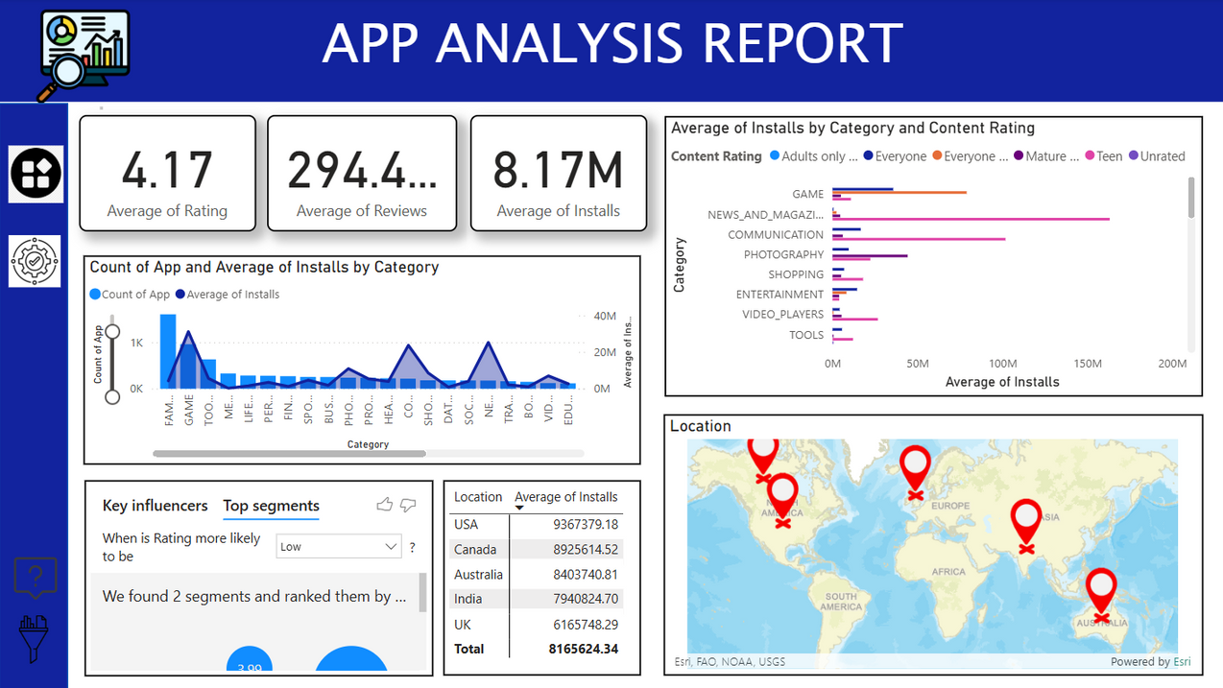
Problem Statement
Abstract
Methodology
Analysis Insights
Conclusion
3) Visualization: (Using Power BI)
Page 1: App Analysis
Conclude: Which country have high installation, Age wise Installation, Which category need new app

Slide 9
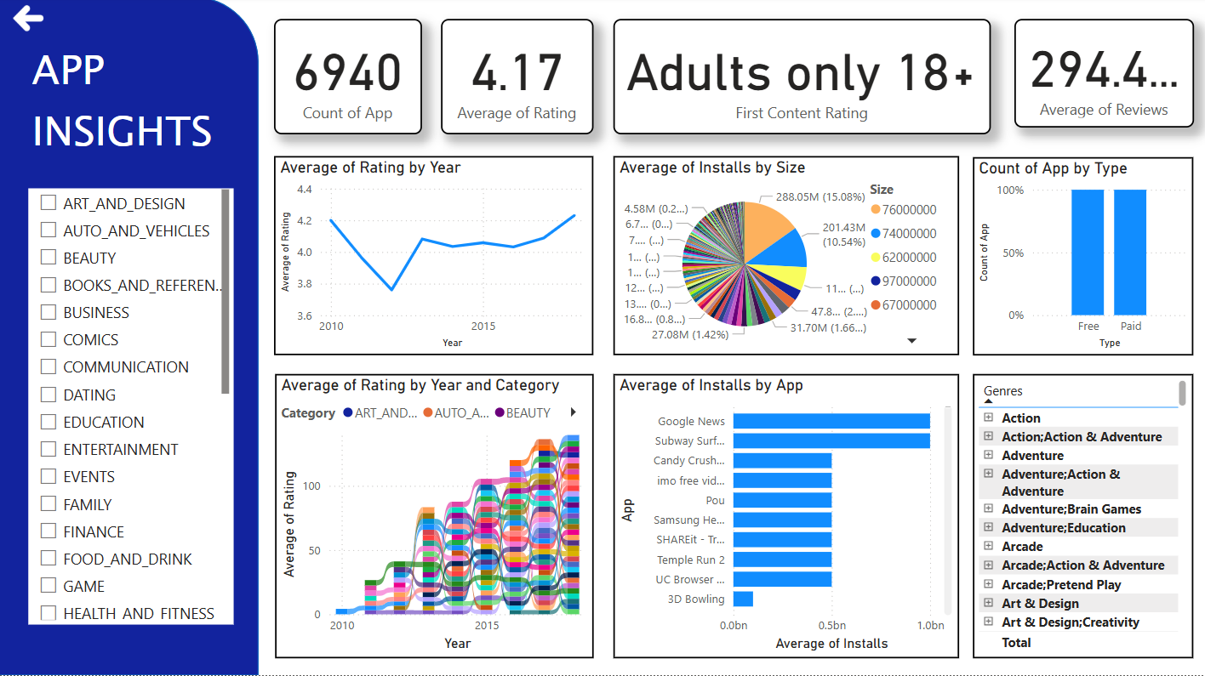
Problem Statement
Abstract
Methodology
Analysis Insights
Conclusion
Page 2: App insights
Conclude: Rating Time series by year, Top apps in Each category, Paid/free status, Current Version Check

Slide 10
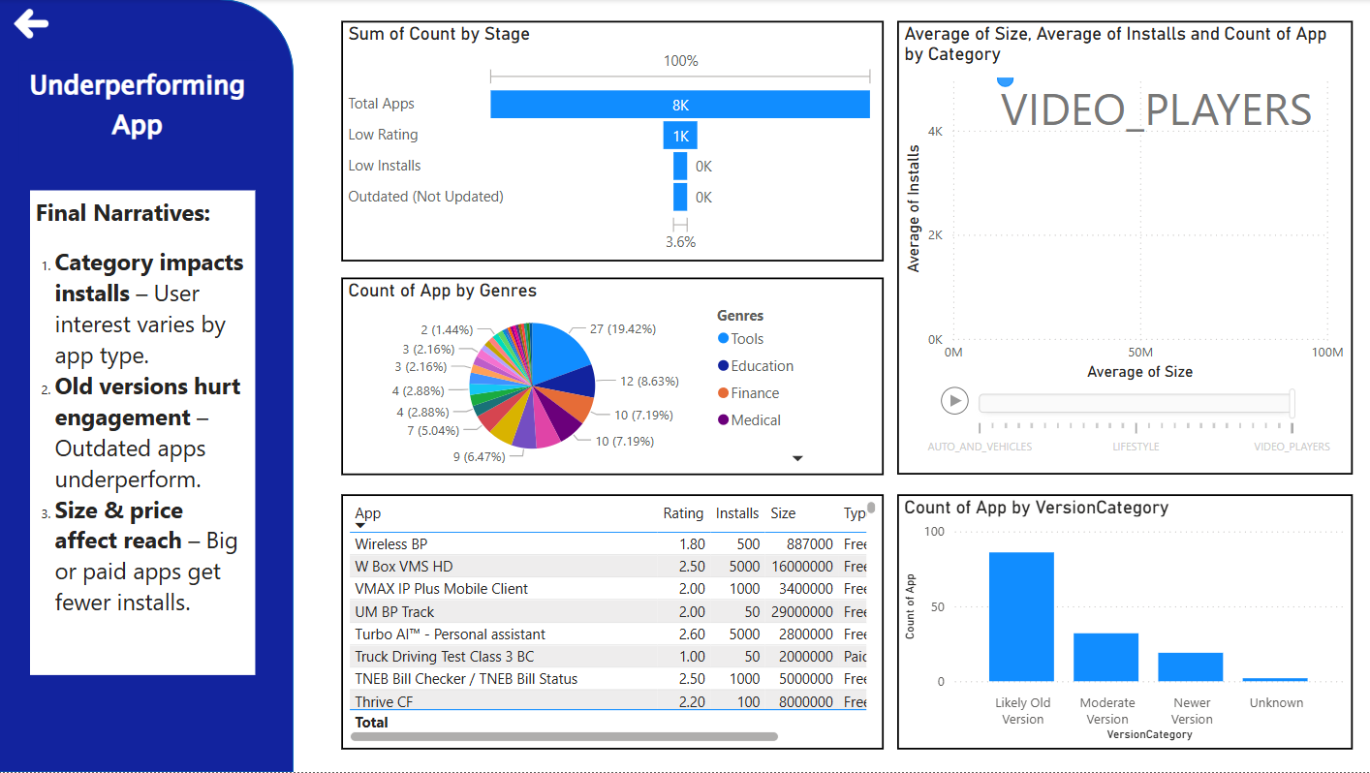
Problem Statement
Abstract
Methodology
Analysis Insights
Conclusion
Page 3: Underperforming App
Conclude: List of Underperforming app by page filter, Categories of version by condition,lifecycle of app

Slide 11
Problem Statement
Abstract
Methodology
Analysis insights
Conclusion
ANALYSIS INSIGHTS
TARGET ATTRIBUTES:(based on to define best app)
i) Average Rating: 4.17
ii)Average Reviews: 294.41 K
iii) Average Installs: 8.17 M
Genre Performance
Top-performing genre: Games, News & Magazines
Low-performing genre: Tools
Improvement needed in: Education and Finance

Slide 12
Problem Statement
Abstract
Methodology
Analysis insights
Conclusion
ANALYSIS INSIGHTS
KEY FINDINGS:
i)Low Install cause Feature
Type, Size and category.
ii)Two Types of High-Rating Apps
Case 1: High rating + high installs → free, small-sized, user-favorite categories
Case 2: High rating + low installs → paid, large-sized, but still in preferred categories
Conclusion: Installs are driven more by category relevance than price or size alone.
iii) Updation Depends on Ratings
Apps with better ratings are more likely to receive regular updates.

Slide 13
Problem Statement
Abstract
Methodology
Analysis Insights
Conclusion
Conclusion
The analysis shows that app installs are mainly driven by category relevance and user needs, not just by price or size. High-rated apps follow two paths: free and lightweight or paid and feature-rich—both in popular categories. Low installs are often due to being paid, large-sized, or in less preferred categories. Also, updates depend on user ratings, highlighting the importance of feedback. Focused improvements in Education and Finance categories can unlock growth opportunities.
RECOMMENDATION:
Focus on popular user-preferred categories. Develop free, lightweight apps to boost installs. Use ratings and feedback to guide updates. Concentrate Game, News and Magazine, Education, and Finance apps

Slide 14

THANK
YOU

